Slide 1
Large Language Models for Autonomous Robot Planning and Acting
Research Talk at Bowling Green State University
Yue Cao Purdue University, ECE yuecao@purdue.edu

Slide 2
Overview
1. Intro: Towards Autonomous Robots
2. LLM for Planning
3. LLM for Acting
4. Future Plan

Slide 3

Kiwibot, 2018: food delivery at UC Berkeley campus

Slide 4
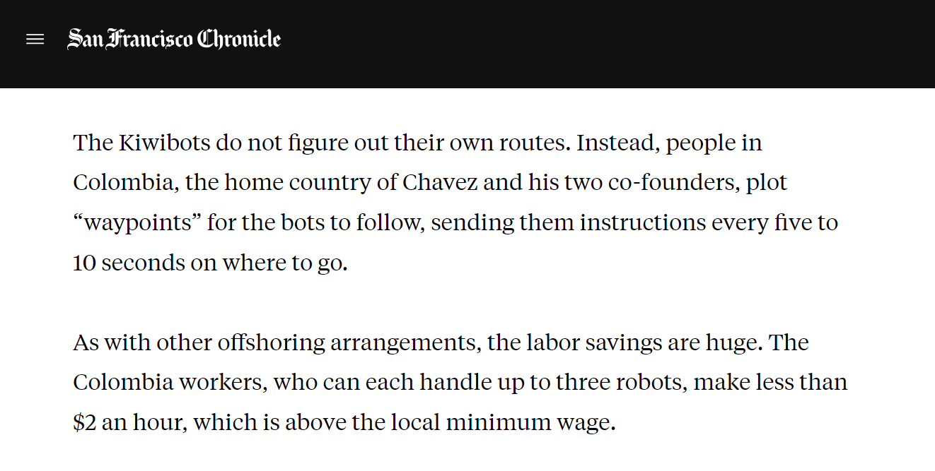
Fake Autonomous Robots
Kiwibot, 2018: food delivery at UC Berkeley campus
What is actually behind?
“Kiwibots win fans at UC Berkeley as they deliver fast food at slow speeds”, San Francisco Chronicle, 2019

Slide 5

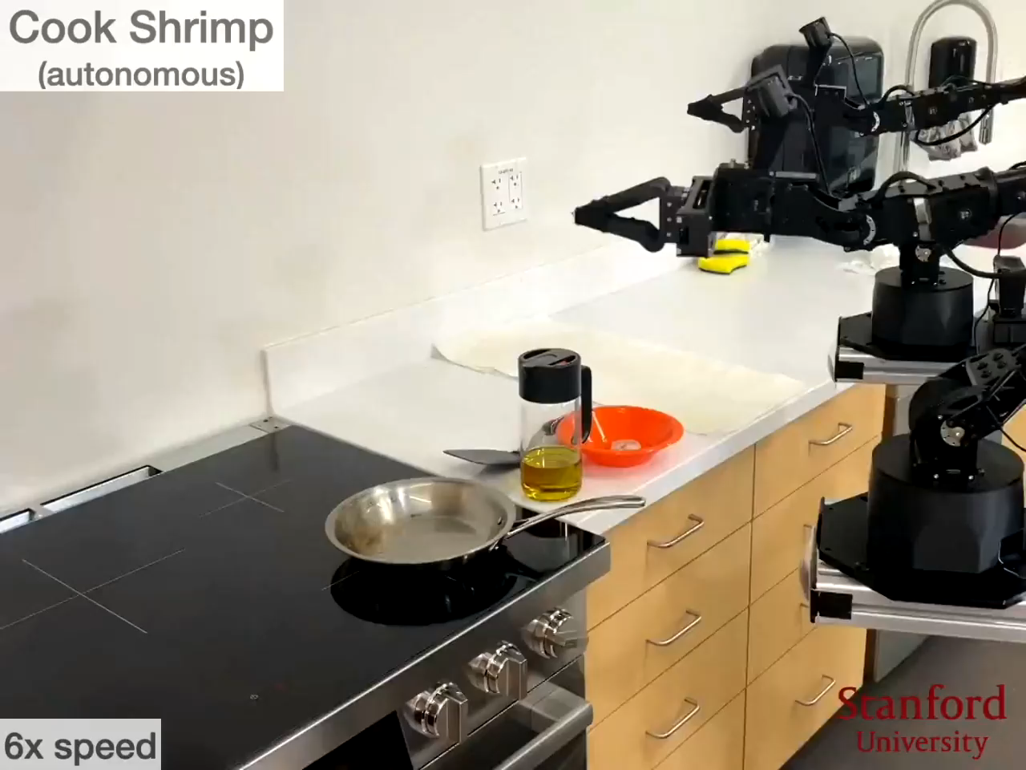
Mobile ALOHA, Stanford, 2024

Slide 6

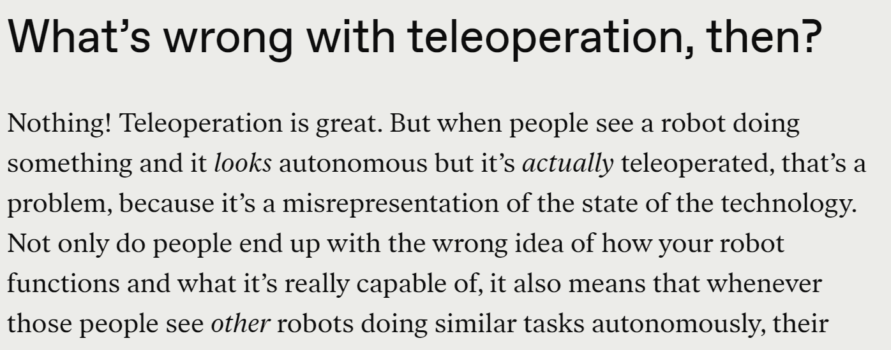
Fake Autonomous Robots
Mobile ALOHA, Stanford, 2024
What is actually behind?
“That Awesome Robot Demo Could Have a Human in the Loop”, IEEE Spectrum, 2024

Slide 7
Towards Real Autonomous Robots

Slide 8
Towards Real Autonomous Robots
Two fundamental questions
1. New technology? Artificial intelligence (AI)
2. Robot capability?
Sense
Plan
Act

Slide 9
Towards Real Autonomous Robots
Two fundamental questions
1. New technology? Artificial intelligence (AI)
2. Robot capability?
My Research Focus
Large Language Models
For
Sense
Planning and Acting
Plan
Act

Slide 10
Overview
1. Intro: Towards Autonomous Robots
2. LLM for Planning
3. LLM for Acting
4. Future Plan

Slide 11
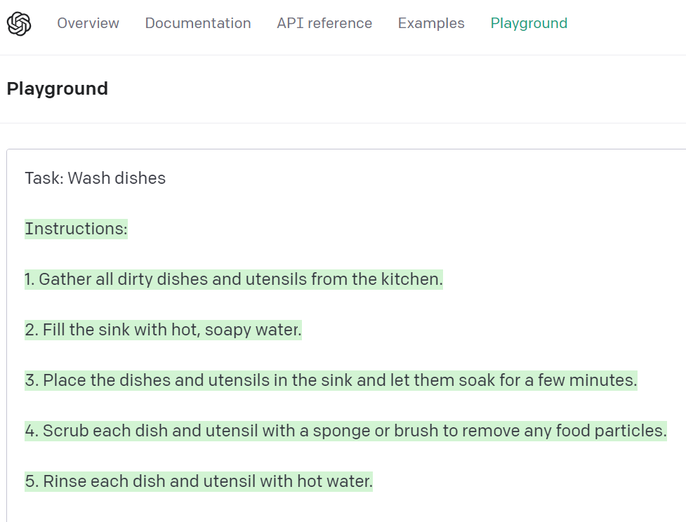
LLM for Planning
My Scope: task planning
GPT can decompose a high-level task into a sequence of sub-tasks.

Slide 12
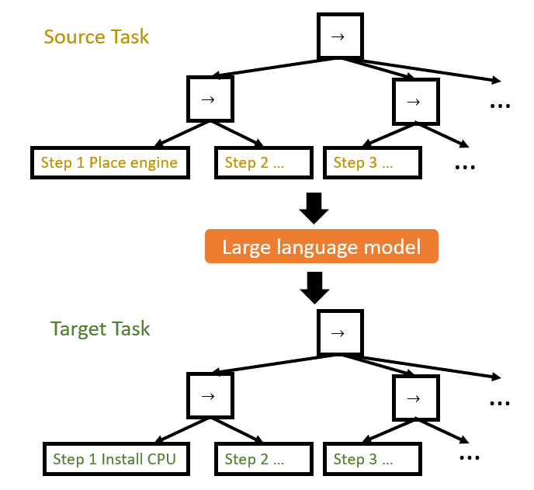
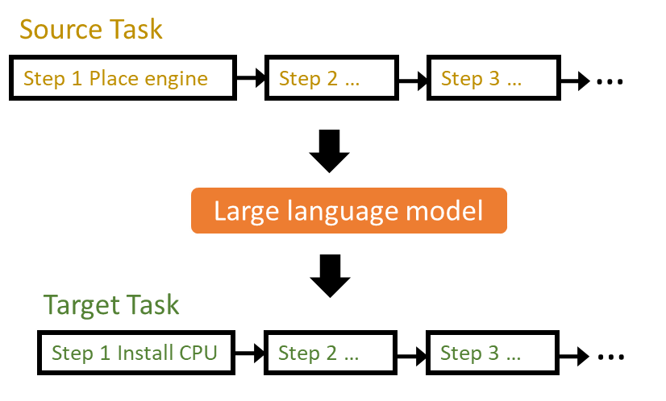
LLM for Planning
Previous works: Generated task are sequential
Can we generate modular tasks? Better reusability and readability
Yue Cao and C. S. George Lee, “Robot Behavior-Tree-Based Task Generation with Large Language Models”, AAAI Spring Symposium, 2023

Slide 13
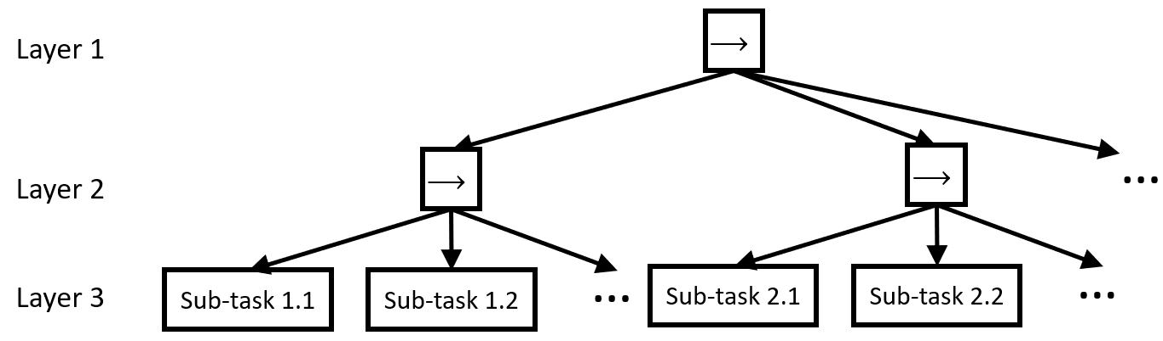

LLM for Planning
Behavior-Tree Task Generation with LLMs
Prompt Design: Phase-Step Prompt
Source Task
Procedures:
Phase 1.
Step 1. [Sub-task 1.1]$_{X}$; Step 2. [Sub-task 1.2]$_{X}$; ...
Phase 2.
Step 1. [Sub-task 2.1]$_{X}$; Step 2. [Sub-task 2.2]$_{X}$; ...
...
Target Task: Task Description
Procedures:
[Phase 1.
Step 1. Sub-task ?; Step 2. Sub-task ?; ...
Phase 2.
Step 1. Sub-task ?; Step 2. Sub-task ?; ...
...]$_{Y}$
A sample behavior tree
Layer 2 node: Phase; Layer 3 node: Step

Slide 14
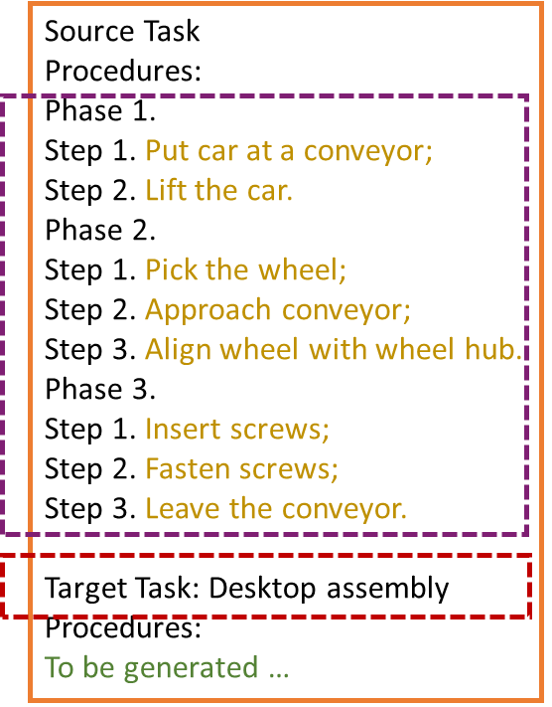
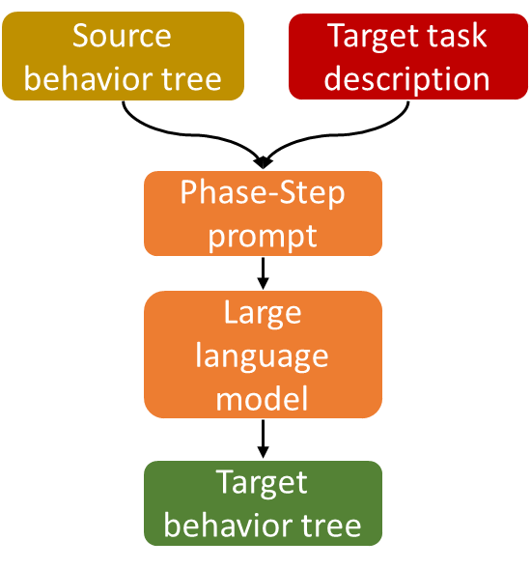
LLM for Planning
Use domain knowledge to improve prompt
Standard way

Slide 15
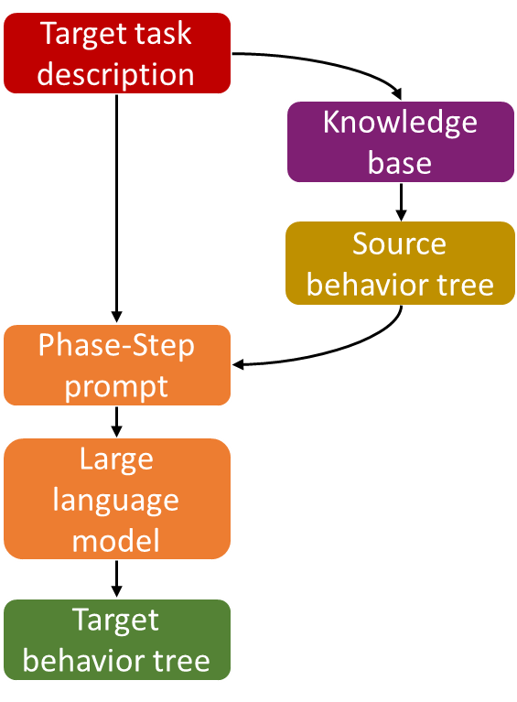
LLM for Planning
Use domain knowledge to improve prompt
Standard way
Better way
no need to write this part now
end-user just inputs this line
Integrate knowledge base retrieval into the pipeline

Slide 16
LLM for Planning
How to retrieve similar tasks from a knowledge base?
Solution: Embedding, mapping an entity into a fixed length vector.
word, document, Amazon product, Netflix movie…(Entity2Vec)

Slide 17

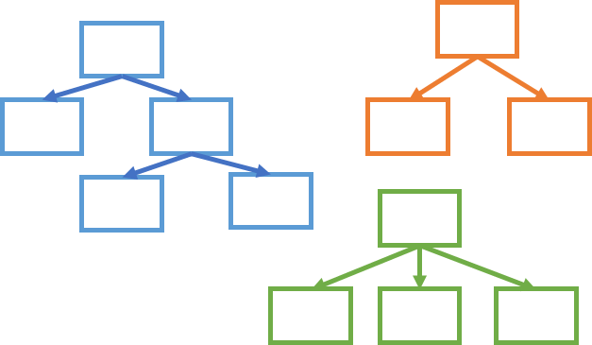
LLM for Planning
Vector Embeddings for behavior-tree tasks
Knowledge base storing tasks
Vector space
Yue Cao and C. S. George Lee, “Behavior-Tree Embeddings for Robot Task-Level Knowledge”, IROS, 2022

Slide 18
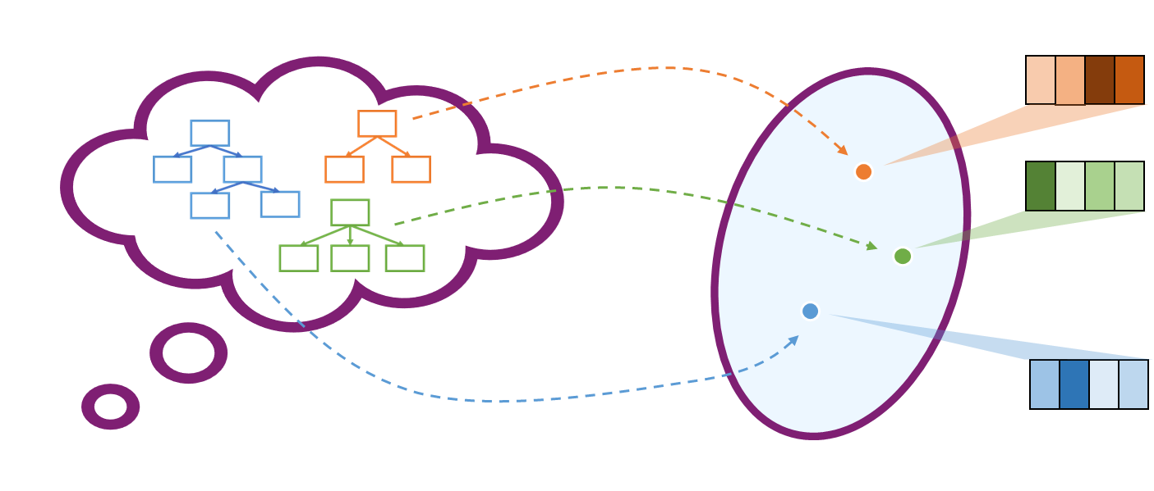
LLM for Planning
Summary of behavior-tree task planning
Vector embedding

Slide 19
LLM for Acting
“Plans ... provide nothing to a robot operationally.” Rodney Brooks, founder of iRobot
These generated tasks are language-described, but they are not yet linked with low-level motor execution.
Using LLMs to realize this process?
Brooks, R. A., “ Planning is Just a Way of Avoiding Figuring Out What To Do Next ﻿ ”, MIT Artificial Intelligence Laboratory, 1987

Slide 20
LLM for Acting
My Scope: manipulator primitive tasks, typically contact-rich.
Recap of manipulator interaction control:
indirect approach
direct approach
impedance control
hybrid position/force control

Slide 21
LLM for Acting
My Scope: manipulator primitive tasks, typically contact-rich.
Recap of manipulator interaction control:
indirect approach
direct approach
impedance control
hybrid position/force control
implicit model setting, need expertise to set parameters
LLMs are bad at math

Slide 22

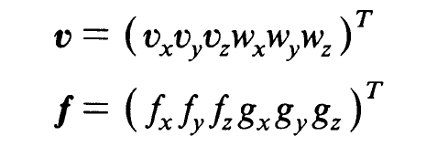
LLM for Acting
My Scope: manipulator primitive tasks, typically contact-rich.
Recap of manipulator interaction control:
indirect approach
direct approach
impedance control
hybrid position/force control
implicit model setting, need expertise to set parameters
simple and structured specification
structured setting called task frame formalism
LLMs are bad at math
LLMs are good at dealing with structured form, think about the example of generating fake citations
Hogan, N., “ Impedance Control: An Approach to Manipulation”, ACC, 1984. doi: 10.23919/ACC.1984.4788393
Mason, M. T., “ Compliance and Force Control for Computer Controlled Manipulators ”, IEEE TSMC, 1981. doi: 10.1109/TSMC.1981.4308708

Slide 23

LLM for Acting
Input: a natural-language-described manipulator primitive task.
Utilize: task frame formalism (TFF)
Output: a set of position/force set-points in the task frame.
joint 1 +10°, joint 2 -20°, joint 3 +5°, …
TFF setpoints
Control algorithm
wipe table?
LLM
Our focus
Already well-studied in hybrid position/force control
Yue Cao and C. S. George Lee, “Ground Manipulator Primitive Tasks to Executable Actions using Large Language Models”, AAAI Fall Symposium, 2023

Slide 24
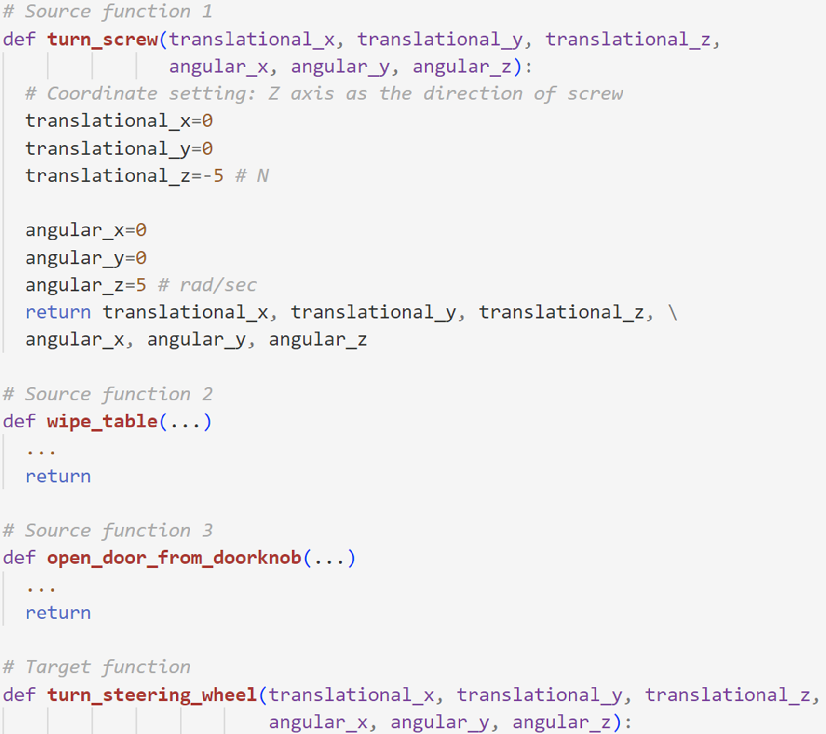
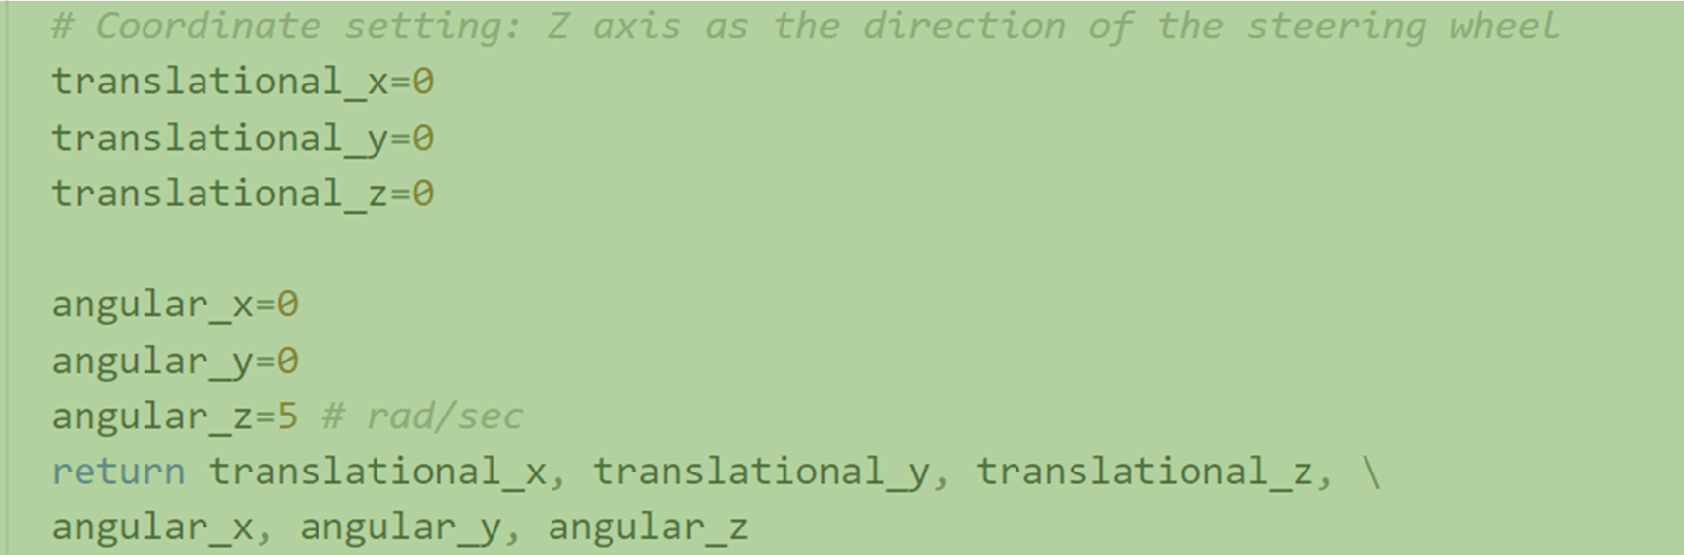
LLM for Acting
LLM
LLM Output
Program-function-like prompt
Task-frame-formalism-based representation
Few-shot inference
3-shot prompt example

Slide 25
Overview
1. Intro: Towards Autonomous Robots
2. LLM for Planning
3. LLM for Acting
4. Future Plan

Slide 26
Towards Real Autonomous Robots
Two fundamental questions
1. New technology? Artificial intelligence (AI)
2. Robot capability?
My Future Research
language model, diffusion model, graph learning, sim2real transfer,
……
Adapt any new AI technique
to robot planning and acting
Sense
Plan
Act

Slide 27

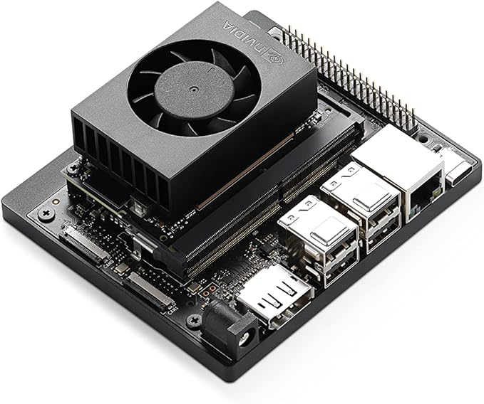
Start-up Request
AI computing
GPUs (for both workstations and mobile devices)
Cloud computing service

Slide 28
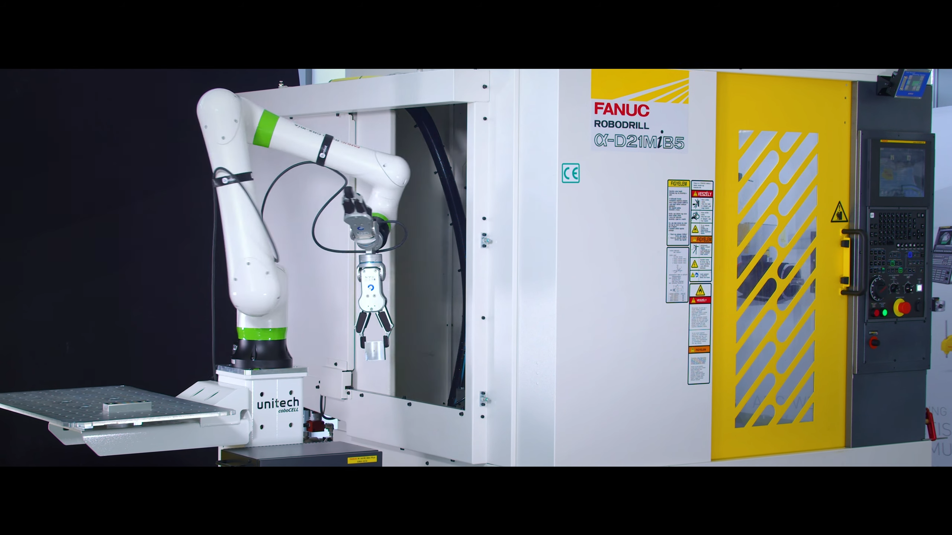
Start-up Request
Robot platform to access
Primarily: manipulator, preferred collaborative type (cobot)
Optionally: legged robot or ground vehicle
Add-on sensors

Slide 29
Overview
1. Intro: Towards Autonomous Robots
2. LLM for Planning
3. LLM for Acting
4. Future Plan
Thanks!
Yue Cao, yuecao@purdue.edu Purdue ECE

